Slide 1
Robot rover shield
For Arduino or Keyestudio MEGA 2560 , Due , Hitex ShiledBuddy TC275 or TC375, Adafruit ntral M4 Express

Slide 2
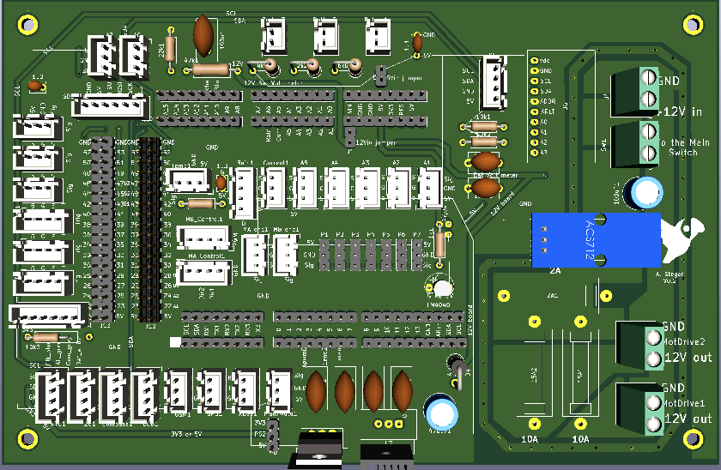
Ports
B
A
C
D

Slide 3
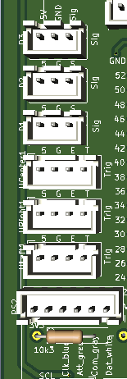
A – Section (navigation sensors)
D3:
5V GND SIG(47)
D2:
5V GND SIG(45)
D1:
5V GND SIG(43)
Ultrasonic (CENTER):
5V GND ECHO(41) TRIGGER(39)
HC-SR04 Ultrasonic sensors:
4k7Ω & 2k7Ω Voltage divider required on ECHO pin ???
Ultrasonic (RIGHT):
5V GND ECHO(37) TRIGGER(35)
Ultrasonic (LEFT):
5V GND ECHO(33) TRIGGER(31)
PS2 controller:
3V3 GND CLK(29) ATT(27) COM(25) DATA(23)
blue green gray white

Slide 4
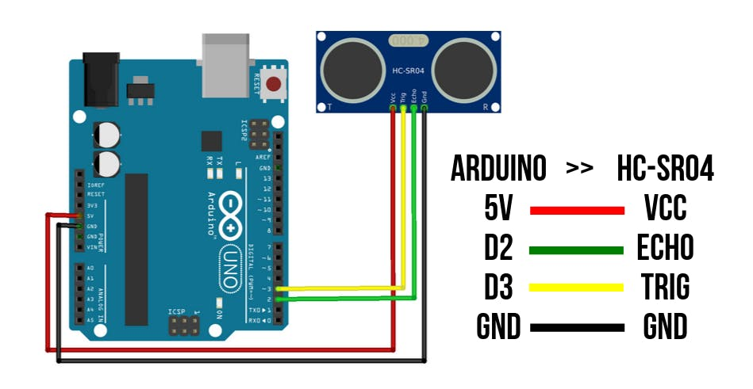
ADUINO & Ultrasonic sensor

Slide 5
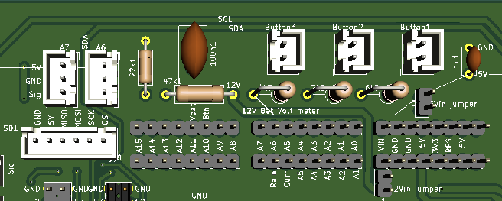
B – Section (SD card & analog Input)
SPI SD card:
GND 5V MISO(50) MOSI(51) SCK(52) CS(53)
A7:
SIG(A15) GND 5V
VBat:
SIG(A11)
Buttons for:
SIG(A10)
A6:
SIG(A14) GND 5V
Button:
SIG(A10)

Slide 6
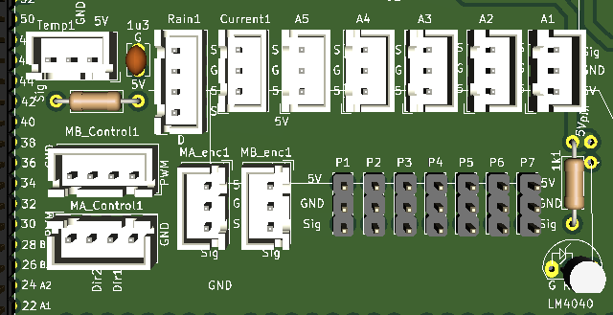
C – Section (Sensors & Motor control)
Rain drop sensor:
SIG(A6) GND 5V SIG(40)
A5 – A1:
SIG(A4 – A0) GND 5V
Temperature sens.:
SIG(46) GND 5V
Current sens.:
SIG(A5) GND 5V
MB_Controll:
GND DIR_B1(28) DIR_B2(26) PWM_B(3)
MA_Controll:
GND DIR_A1(22) DIR_A2(24) PWM_A(2)
MA_Encoder:
SIG(4) GND 5V
MB_Encoder:
SIG(5) GND 5V
P1-P7:
SIG(7-13) GND 5V

Slide 7
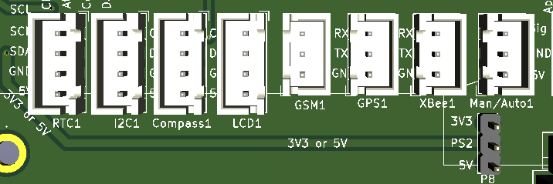
D – Section (I2C & Serial communication)
TX0 /RX0 is for Jetson Nano on normal serial connector !
(Current mearument: ADS1115
ADDR pin to GND -> 0x48)
GSM (1):
TX1 RX1 GND
GPS (2):
TX2 RX2 GND
XBEE (3):
TX3 RX3 GND
Flip in RTC the GND & 5V positions !!!:
DS3231 RTC (0x57 I2C):
5V GND SDA SCL
BNO055 9-DOF Compass
(0x28 I2C): 5V GND SDA SCL
Maual/Auto:
5V GND SIG(6)
I2C (free I2C):
5V GND SDA SCL
LCD2004 (0x27, I2C):
5V GND SDA SCL

Slide 8
Power management (for 5V MCUs)
Jumper for 5V IN
5V from buck power supply
12V IN
for 2 motors, shield & MCU
For main & safety switch
Jumper for 12V IN
(not in use)
Fuses
12V OUT
or 2 motors
Jumper for PS2 5V? or 3V3
5V to 3V3 regulator for PS2 only
12V or 24V to 5V mini buck converter. This can be replaced to 12V to 3V3 for DUE

Slide 9
Power measurement
ADS1115
ACS712 Sig to ADS1115’s A3
10k/10k to ADS1115’s A2
SCL SDA GND 5V
Mesure internal ref 2.56V with separayte Arduin sketch as well ! Measure_intRefVolt.ino
10kΩ & 47kΩ (measre before soldering !) BatRs[] = voltage deivider for battery volt measurement Signal to A11
ADS1115
ADDR pin to GND -> 0x48
2x 10kΩ voltage divider for ADS1115
Current measurrment
ACS712 (30A)
5V Sig GND
Sig to ADS1115’s A3
1kΩ & LM4040_2.5 V
for V ref
Or connect signal
of ACS712 to A5

Slide 10
How use jumpers for 3V3 MCU’s (Due etc.)
Jumper for 3V3 IN
3V3 from buck power supply
Jumper for PS2 put on 3V3
Populate here 3V3 regulator only
No regulator req. here. Use 3V3 PS2 only !

Slide 11
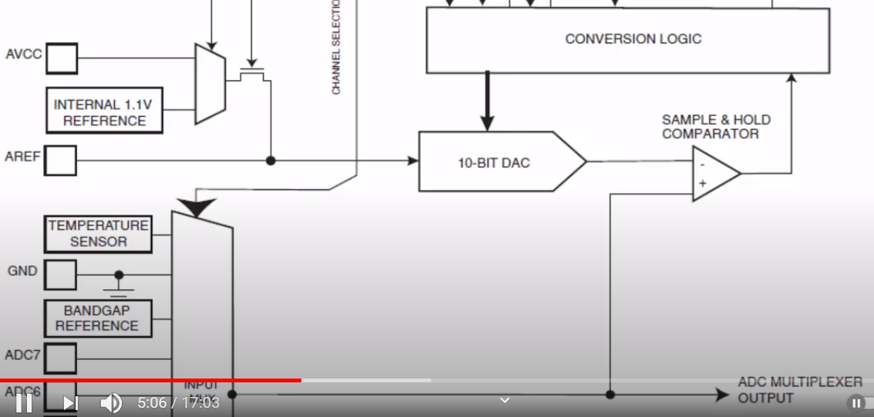
https://www.youtube.com/watch?v=E8GqHvOK4DI&t=646s

Slide 12
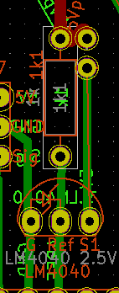
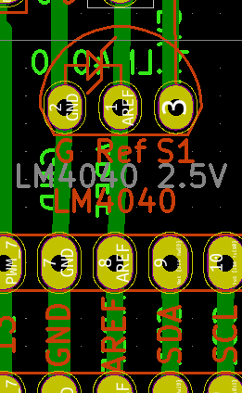
Vref: setup external reference voltage for accurate measurment
5V from “5V” pin of the MCU
Bypass jumper to make a separate small PCB for Vref (ferrite signal susp etc.)
GND & 5V for Vref PCB
Signal out on Ref pin

Slide 13
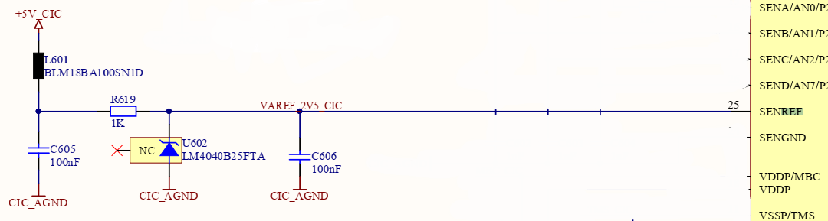
V ref mini PCB for improvement

